Slide 1
OPTIMIZED TAXI PRE-BOOKING SYSTEM
SLOT - C2 || GROUP - G12
Guided by :-
Prof Santanu Mandal

Slide 2
TEAM MEMBERS
18BCD7165 MADDINENI AASHIKA
18BCN7079 DEVI JAGANNADH KOTHA
18BCN7057 PADUCHURU ABHISHEK
18BCD7009 RISHABH SINGH BAIS
18BCE7236 SUNKARA YASWANTH REDDY

Slide 3
INTRODUCTION
Taxi is an important transportation mode between public and private transportations, delivering millions of passengers to different locations in urban areas.
A Taxi is a type of vehicle for hire with a driver, used by a single Customer or small group of Customers often for a non-shared ride.
The service will run at real-time as or at a time designated by the client. This Taxi & Cab Management System is helpful for travel agencies for their cabs, taxis, and their vehicle maintenance.

Slide 4
OBJECTIVE
The main objective of this project is making more rides by less taxis by using taxi scheduling.
Taxis play an important role in modern public transportation. In this project we are going to propose a new technique which is more economical for customers and very environmentally friendly called taxi scheduling.
This project will help in getting more profits for the company.

Slide 5
METHODOLOGY
In this mini-project we have used graph coloring concept of discrete mathematics and greedy algorithm to improvise the existing system of taxi pre-booking.
We have implemented this using java programming.

Slide 6
GRAPH COLORING CONCEPT
Graph coloring is nothing but a simple way of labelling graph components such as vertices, edges, and regions under some constraints. In a graph, no two adjacent vertices, adjacent edges, or adjacent regions are colored with minimum number of colors. This number is called the chromatic number and the graph is called a properly colored graph.
While graph coloring, the constraints that are set on the graph are colors, order of coloring, the way of assigning color, etc. A coloring is given to a vertex or a particular region. Thus, the vertices or regions having the same colors form independent sets.

Slide 7
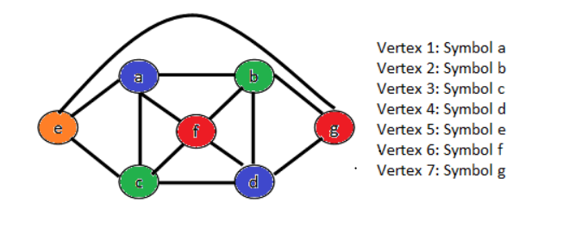
Pictorial representation

Slide 8
Applications of graph colouring:-
Graph coloring is one of the most important concepts in graph theory. It is used in many real-time applications of computer science such as −
Clustering
Data mining
Image capturing
Image segmentation
Networking
Resource allocation
Processes scheduling

Slide 9
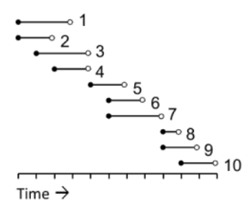
THEORETICAL CONCEPT
Let's take an example on taxi scheduling:-
No. of Rides

Slide 10
We can construct a graph from this information by using one vertex for booking and then adding edges between any vertex pair corresponding to overlapping bookings.
Convert problem into a graph coloring problem
Bookings are represented by vertices
Two vertices are connected by an edge if the corresponding Bookings have overlapping Bookings.

Slide 11
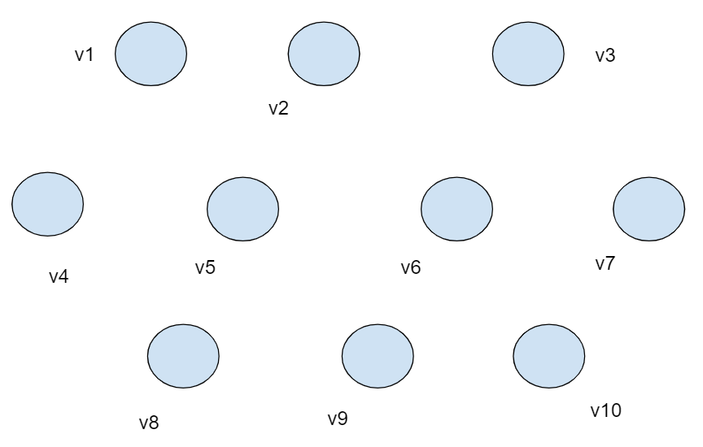
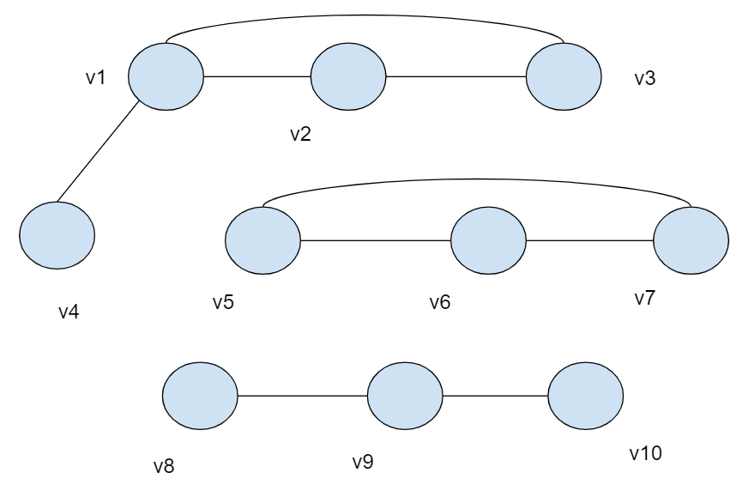
Connect the vertices according to overlapping of booking.

Slide 12
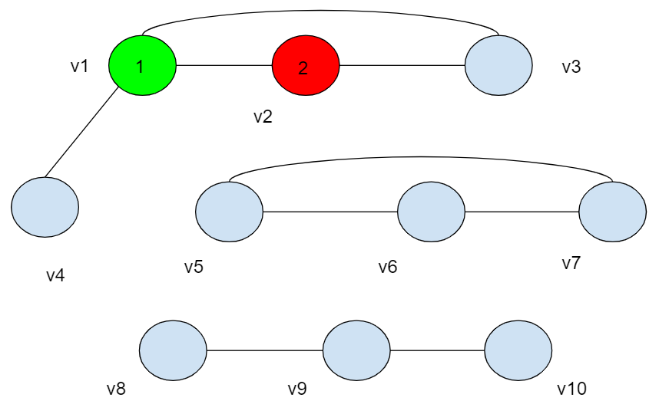
Color a vertex with color 1.
Pick an uncolored vertex v. Color it with the lowest-numbered color that has not been used on any previously colored vertices adjacent to v. (If all previously-used colors appear on vertices adjacent to v, this means that we must introduce a new color and number it.)
Repeat the previous step until all vertices are colored.

Slide 13
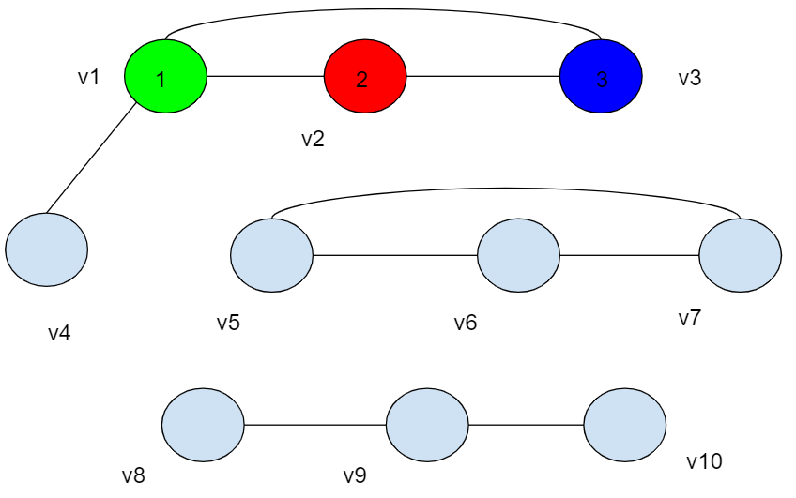
Clearly the graph is obviously not 1-colorable because there exist edges. So try it with 2-coloring by using color 1 (green) and color 2 (red)
Colors using : 1. Green 2. Red Now, color vertex v1 with color 1(green) and v2 with color 2(red)
v3 is connected with both v1 and v2, we can't give color 1(green) and color 2(red) colors. So we introduce a new color, color 3(Blue) to color v3 and the graph results in 3-coloring.
Updated Colors using : 1. Green 2. Red 3. Blue

Slide 14
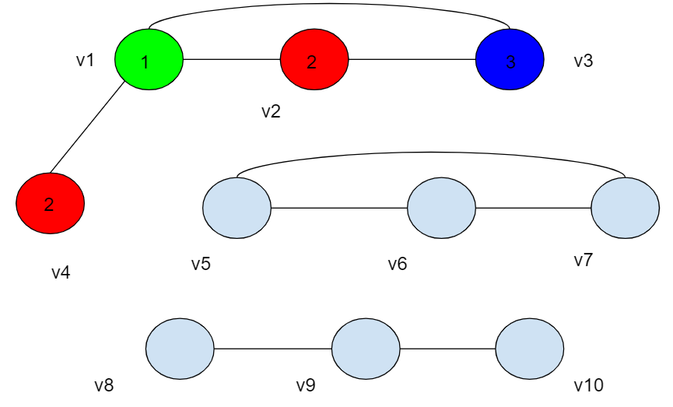
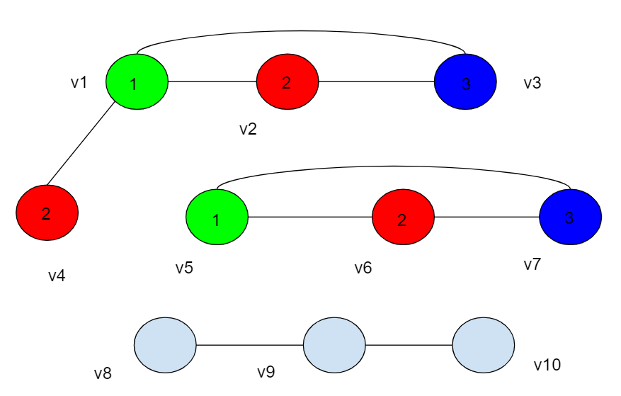
Next consider vertex v4 as it is connected with v1 it prevents the usage of color 1(green) so we choose Red(2) because we always need to check from lowest numbered color.
Similarly, we start again with vertex v5 color with color 1(green).
Vertex v6 can't be color 1(green)so we give next color, color 2(red).
Vertex v7 can't be color 1(green) and color 2(red) so we give it color 3(Blue).

Slide 15
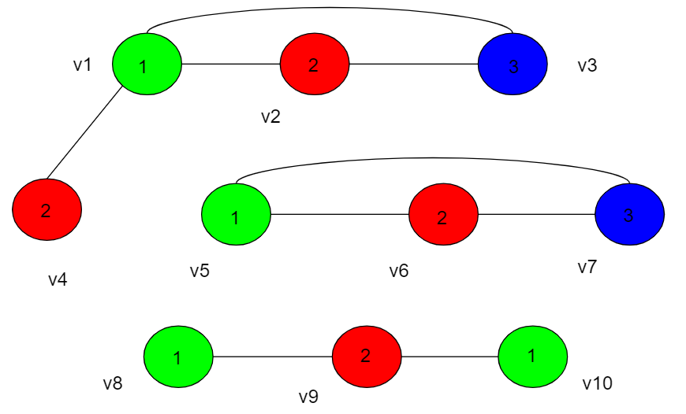
Consider vertex v8 and color it with color 1(green).
Vertex v9 can't be color 1(green) so we give next color, color 2(red).
Vertex v10 can't be color 2(red) so we go to the lowest number color and give it Green.
We see that the quality of our coloring (with fewer colors being considered better) from the Greedy Coloring Algorithm is dependent on the order in which we color the vertices.

Slide 16
ALGORITHM
Declare and initialize all the required variables.
Create the graph using the ride times.
Find overlapping rides and creating a edge between those vertices.
Perform DFS for all vertices[in case of disconnected graph].
Find the color used in the adjacent vertices of the current vertex.
Find the least number color we can use[currently unused].
Assigning that color the the current vertex.
Find the total number of taxis used[1 indexed].

Slide 17
CONCLUSION
We can conclude from our project that it will increase efficiency of our existing system, which will decrease company’s cost and result in less use of taxis and result in less environmental pollution. More economical, very environmentally friendly.

Slide 18
REFERENCES
https://en.wikipedia.org/wiki/Graph_coloring#References
https://webdocs.cs.ualberta.ca/~joe/Coloring/index.html
https://www.researchgate.net/publication/260026333_A_novel_approach_to_indeendent_taxi_scheduling_problem_based_on_stable_matching
https://www.researchgate.net/publication/234163991_Multi-agent_real_time_scheduling_system_for_taxi_companies

